Slide 1
CS663 Data Mining Final Project Cluster Weather Data using K-Means Group 3
Dallin Steele, Amit Chaudhary, Chenghui song, Ankit Anand, Trenton Tidwell

Slide 2
So you want to move to the United States?
Data Mining Question:
Scenario – an individual is:
Moving to the United States from another country
Has the freedom to move to any location in the mainland
High desire to move a location with similar weather to where they are moving from
Question:
What locations on the mainland of the United States have similar weather to where this individual is from?

Slide 3
Introduction
Project Name: Weather Data Clustering using K-Means
Group Members: Dallin Steele, Amit Chaudhary, Chenghui song, Ankit Anand, Trenton Tidwell
Group Number: 3
High level Overview:
Obtained weather data on precipitation and temperature from NOAA
Data preprocessing
Clustered weather station data
Lookup feature to take an address and find clusters of weather stations with similar weather

Slide 4

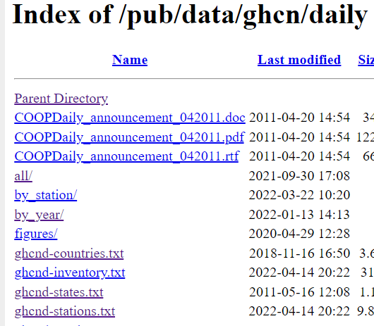
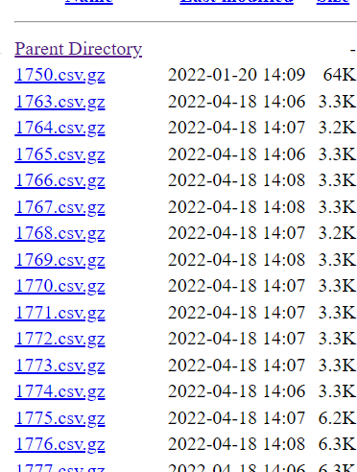
Data Source

Slide 5
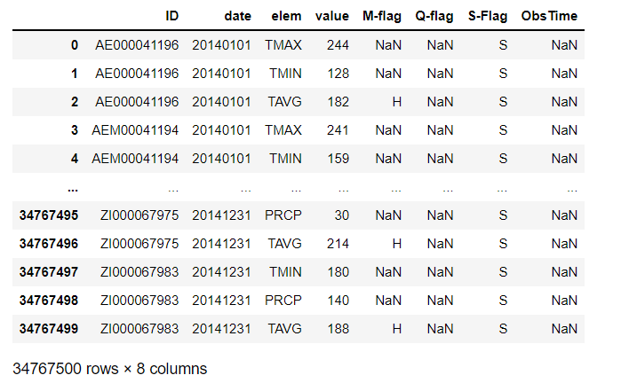
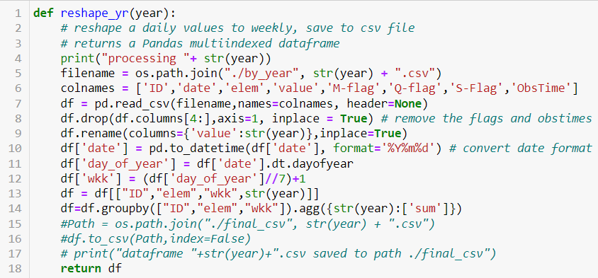
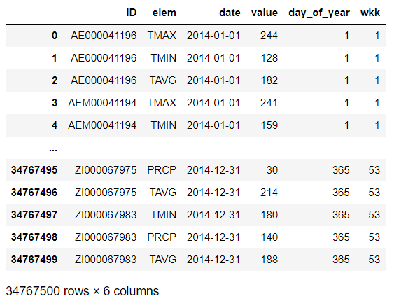
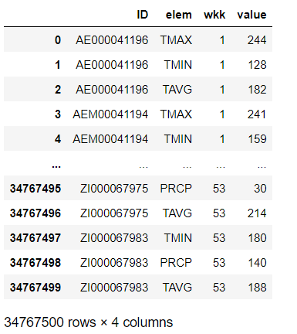
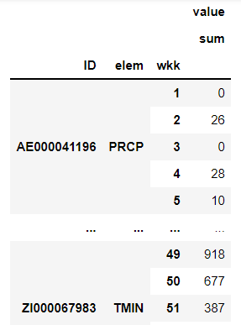
Data Preprocessing

Slide 6

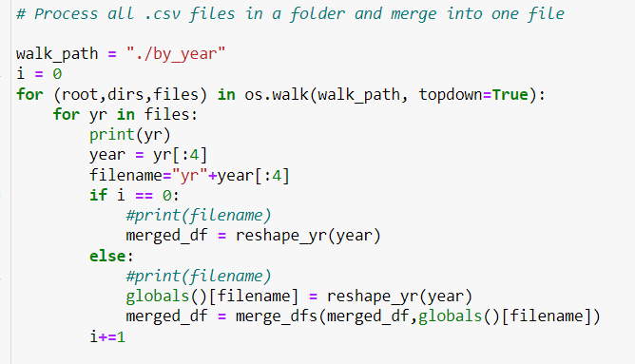
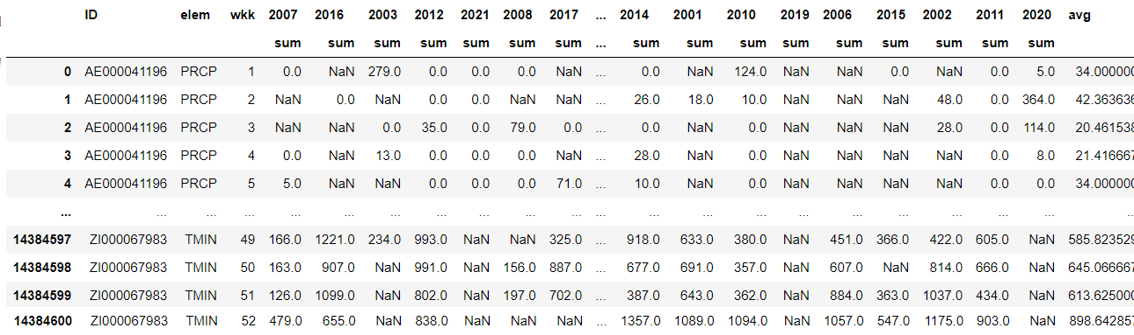
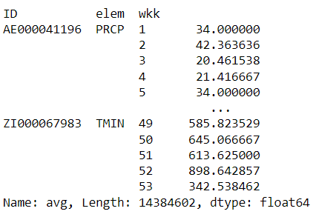
Data Preprocessing

Slide 7
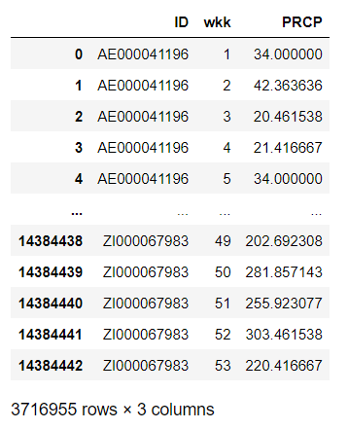
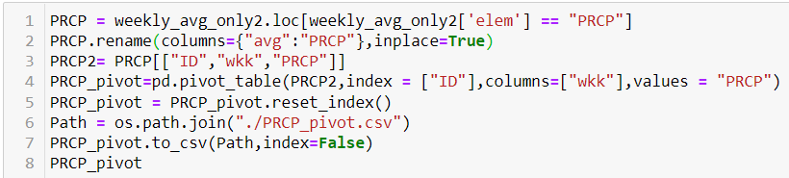
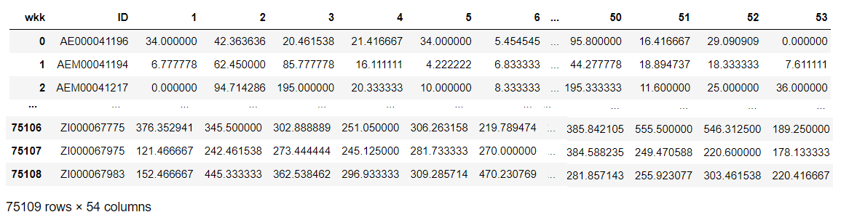
Data Preprocessing

Slide 8
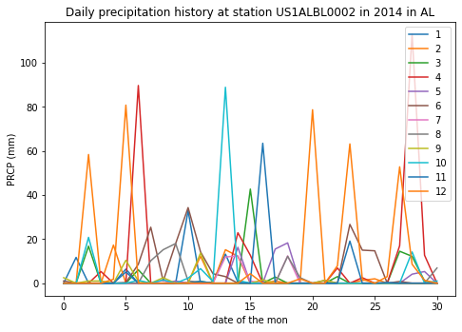
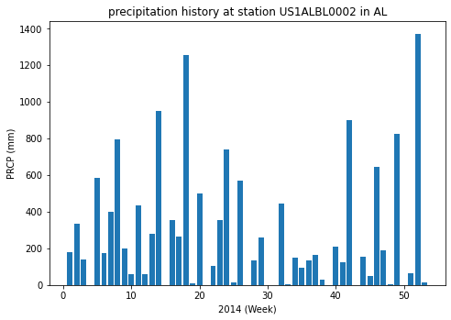
Data Preprocessing

Slide 9
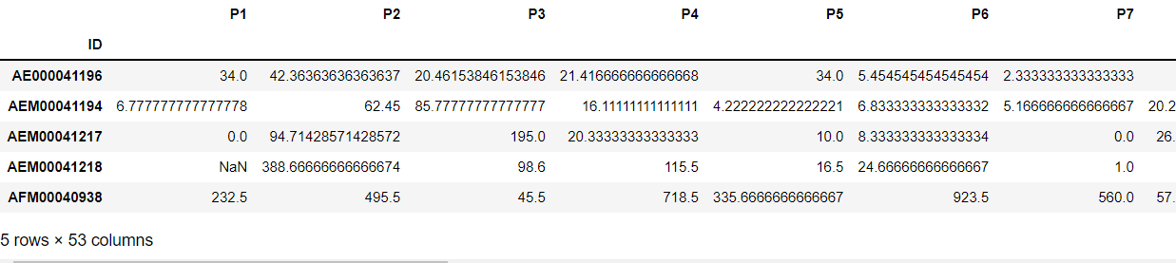
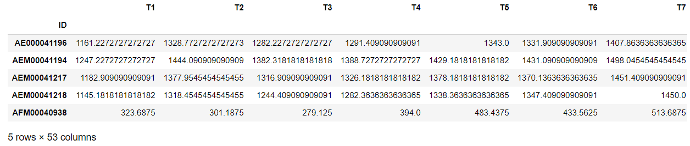
Data Preprocessing

Slide 10
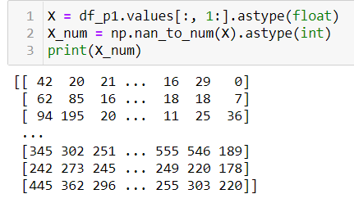
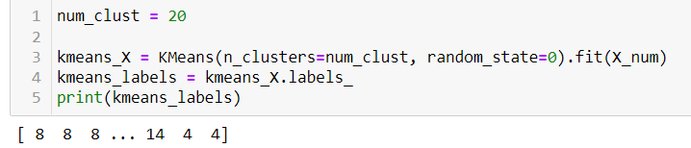
Model Test with Precipitation only
KMeans Model

Slide 11
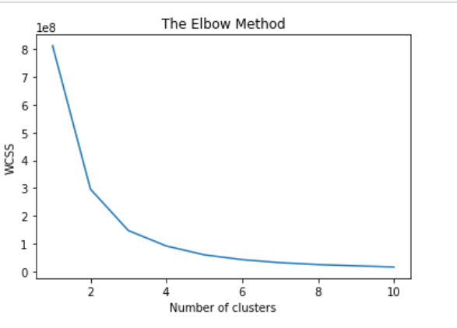
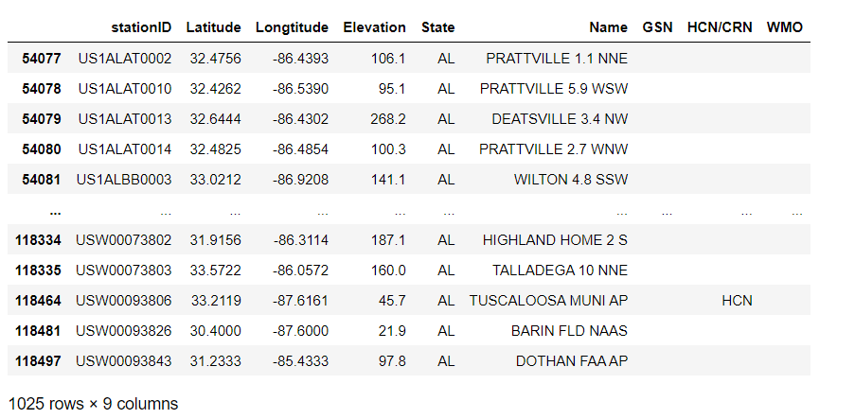
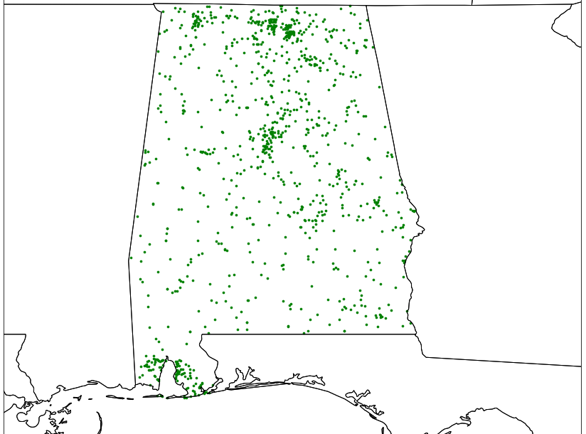
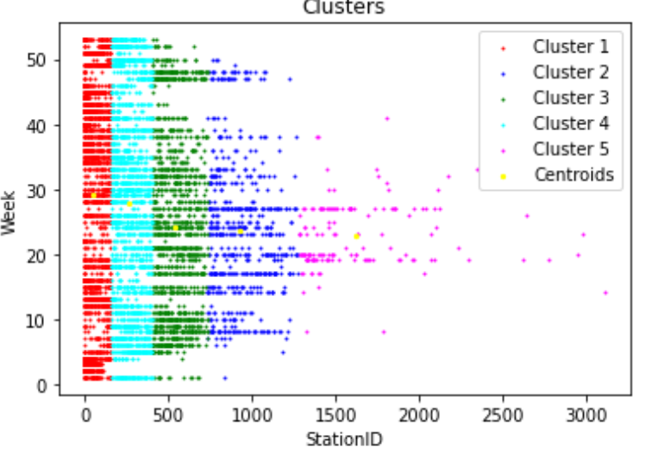

Slide 12
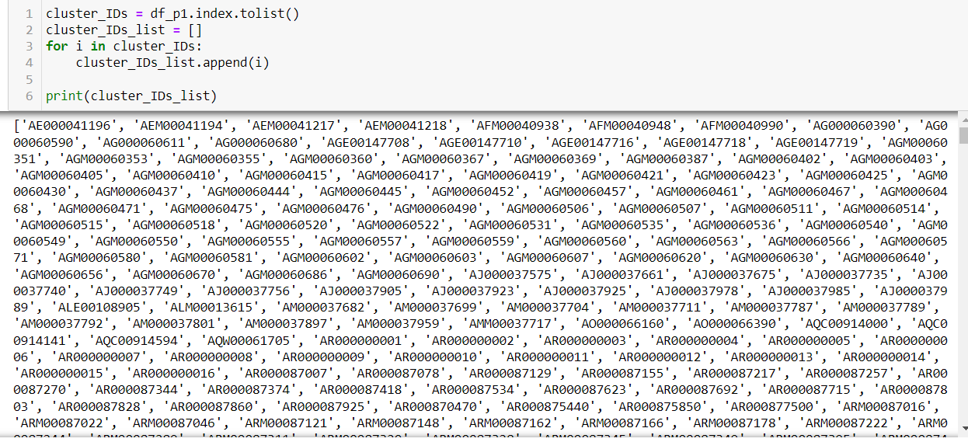
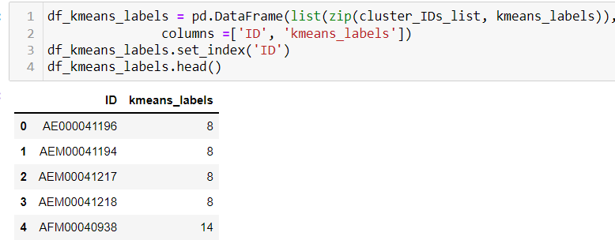
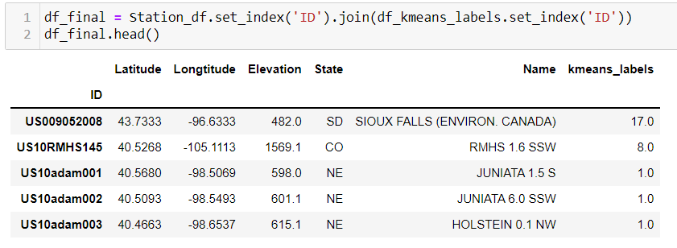
Model Test with Precipitation only

Slide 13
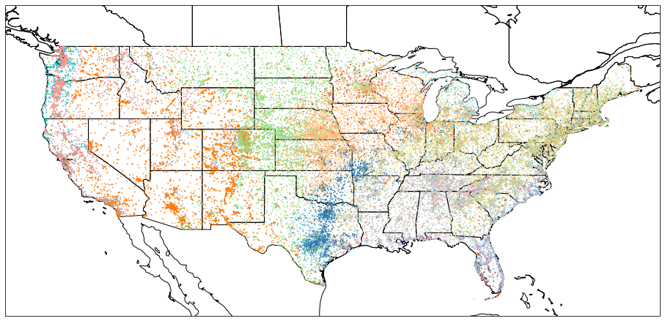
Model Test with Precipitation only

Slide 14
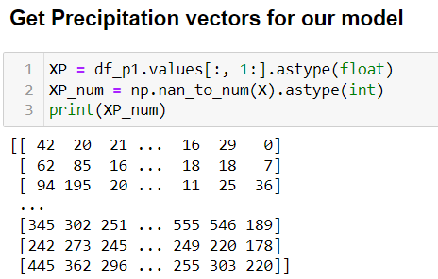
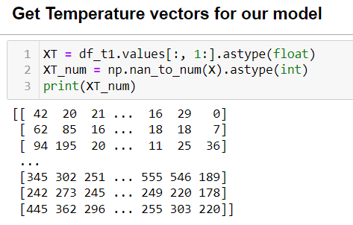
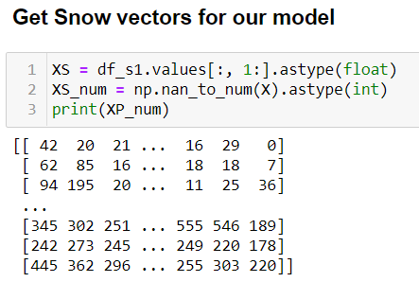
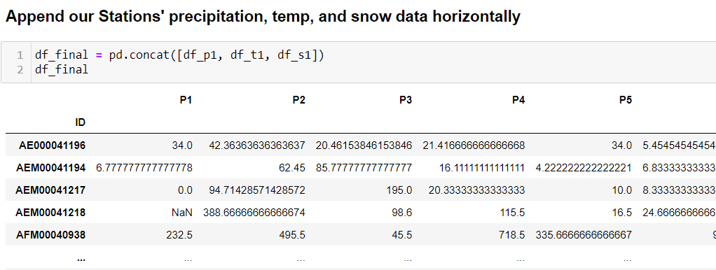
New Model with Additional Features

Slide 15
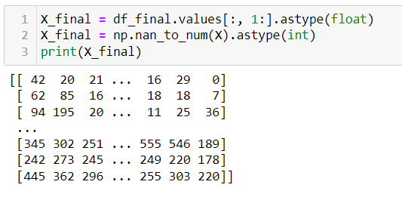
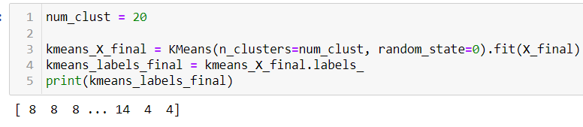
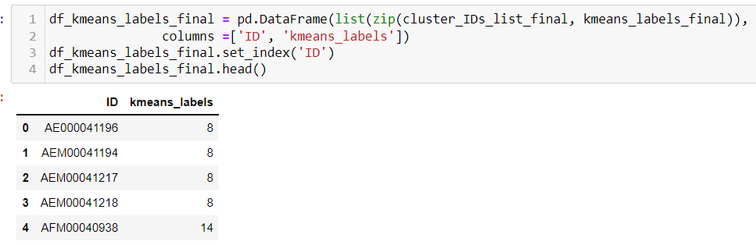
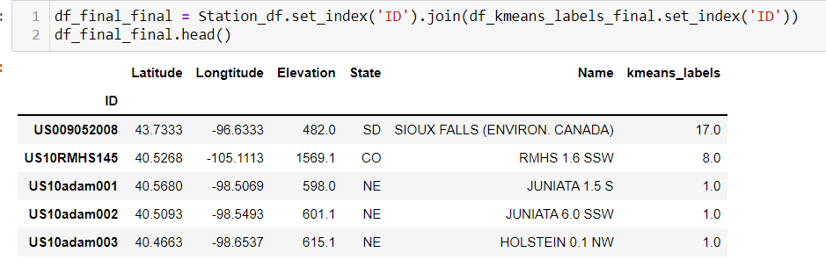
New Model with Additional Features

Slide 16
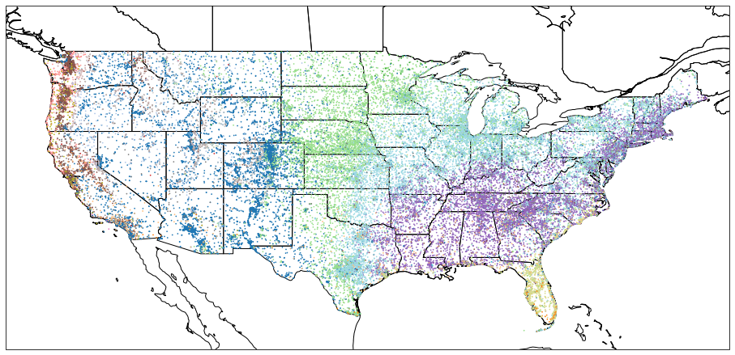
New Model with Additional Features

Slide 17
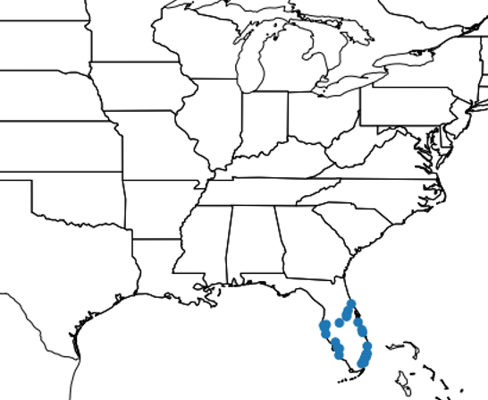
Lookup Feature
Chandkheda, Ahmedabad, Gujarat, India 382424
Takes an address and finds a related GPS coordinate
Finds the closest weather station
Finds weather stations with related weather based on clustering results
Returns plot of weather stations with similar weather

Slide 18
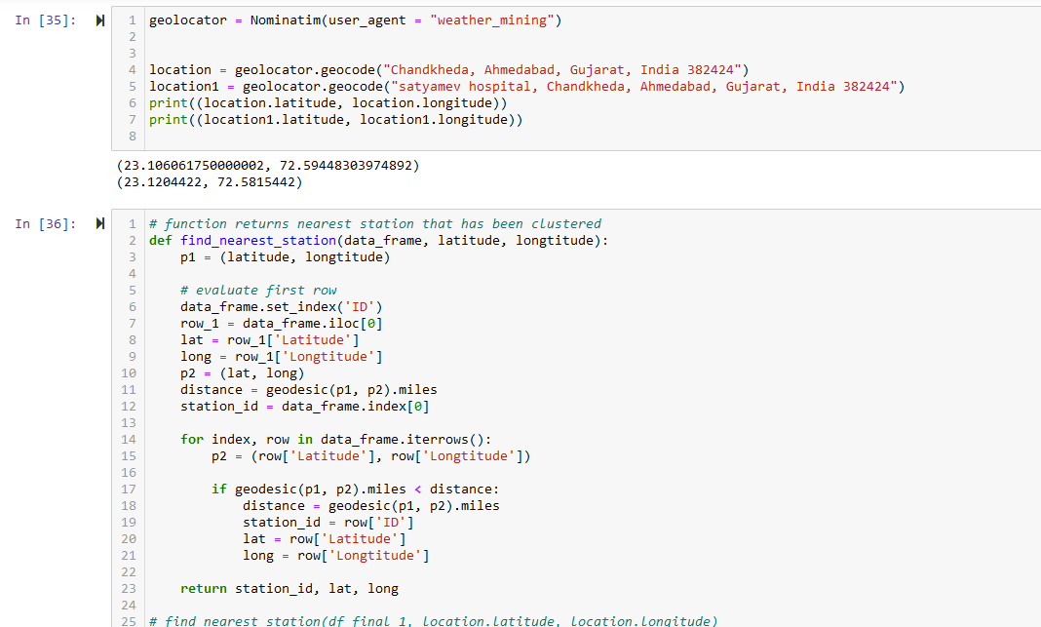
Adding the lookup feature using geocode

Slide 19
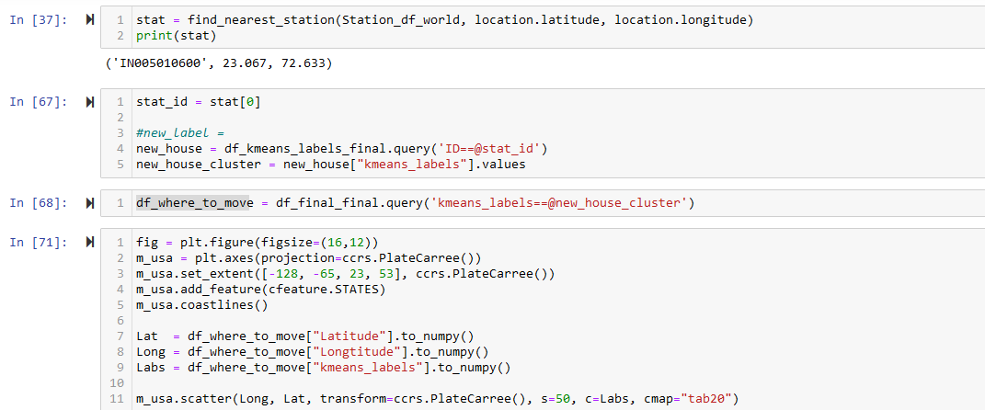
Find the Nearest Station to a given Lat, Long Then Run That Station's Vector into the Model

Slide 20
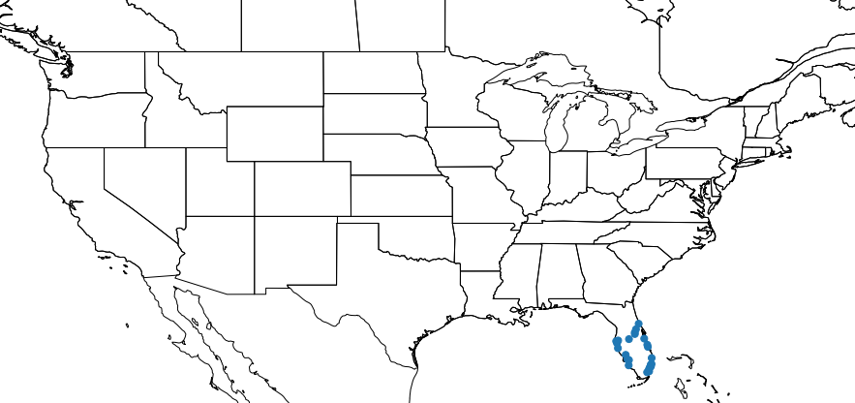
Results Given the Input of "Chandkheda, Ahmedabad, Gujarat, India 382424"

Slide 21
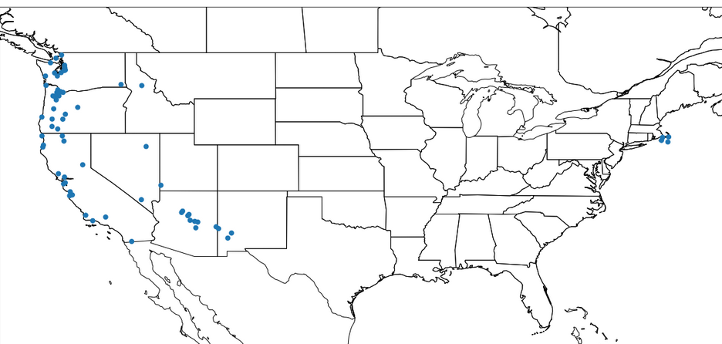
Results Given the Input of "1 Waverley Pl, London NW8 0NP, United Kingdom"

Slide 22
Conclusion
Obtained weather data on precipitation and temperature from NOAA
Data preprocessing took csv file and produced Pandas Dataframes
Clustered weather station data using Kmeans and Elbow
Lookup feature to take an address and find clusters of weather stations with similar weather
India --> Florida
England → Coastal Areas (see map)

Slide 23
Thank You!!!

